Slide 1
Programming Fundamentals
By
Shazmeen Batool

Slide 2
Previous Lecture
Structures and Functions
Structures and Pointers

Slide 3
Today’s Lecture
Introduction to File Handling

Slide 4
Using Files for Data Storage
When a program needs to save data for later use, it writes the data in a file. The data can then be read from the file at a later time.
The programs you have written so far require the user to reenter data each time the program runs, because data kept in variables and control properties is stored in RAM and disappears once the program stops running.
If a program is to retain data between the times it runs, it must have a way of saving it.

Slide 5
Using Files for Data Storage
Data is saved in a file, which is usually stored on a computer’s disk.
Once the data is saved in a file, it will remain there after the program stops running.
Data that is stored in a file can be then retrieved and used at a later time.

Slide 6
Using Files for Data Storage
Most of the commercial software that you use on a day-to-day basis store data in files. The following are a few examples.
Word processors: Word processing programs are used to write letters, memos, reports, and other documents. The documents are then saved in files so they can be edited and printed.
Image editors: Image editing programs are used to draw graphics and edit images such as the ones that you take with a digital camera. The images that you create or edit with an image editor are saved in files.

Slide 7
Using Files for Data Storage
Spreadsheets: Spreadsheet programs are used to work with numerical data. Numbers and mathematical formulas can be inserted into the rows and columns of the spreadsheet. The spreadsheet can then be saved in a file for use later
Web browsers: Sometimes when you visit a Web page, the browser stores a small file known as a cookie on your computer. Cookies typically contain information about the browsing session, such as the contents of a shopping cart.

Slide 8
Using Files for Data Storage
Games: Many computer games keep data stored in files. For example, some games keep a list of player names with their scores stored in a file. These games typically display the players’ names in order of their scores, from highest to lowest. Some games also allow you to save your current game status in a file so you can quit the game and then resume playing it later without having to start from the beginning.

Slide 9
Using Files for Data Storage
Programs that are used in daily business operations rely extensively on files.
Payroll programs keep employee data in files, inventory programs keep data about a company’s products in files, accounting systems keep data about a company’s financial operations in files, and so on.

Slide 10
Using Files for Data Storage
Programmers usually refer to the process of saving data in a file as writing data to the file.
When a piece of data is written to a file, it is copied from a variable in RAM to the file.
An output file is a file that data is written to.
It is called an output file because the program stores output in it.

Slide 11
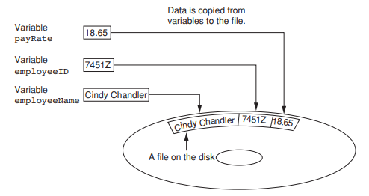
Writing data to a file

Slide 12
Using Files for Data Storage
The process of retrieving data from a file is known as reading data from the file.
When a piece of data is read from a file, it is copied from the file into a variable in RAM.
An input file is a file that data is read from.
It is called an input file because the program gets input from the file.

Slide 13
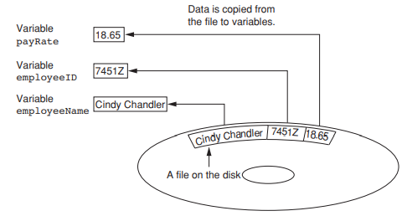
Reading data from a file

Slide 14
Using Files for Data Storage
When a file is used by a program, three steps must be taken.
Open the file—Opening a file creates a connection between the file and the program. Opening an output file usually creates the file on the disk and allows the program to write data to it. Opening an input file allows the program to read data from the file.

Slide 15
Using Files for Data Storage
Process the file—Data is either written to the file (if it is an output file) or read from the file (if it is an input file).
Close the file—After the program is finished using the file, the file must be closed. Closing a file disconnects the file from the program.

Slide 16
Types of Files
In general, there are two types of files: text and binary.
A text file contains data that has been encoded as text, using a scheme such as ASCII or Unicode. Even if the file contains numbers, those numbers are stored in the file as a series of characters. As a result, the file may be opened and viewed in a text editor such as Notepad.
A binary file contains data that has not been converted to text. Thus, you cannot view the contents of a binary file with a text editor.

Slide 17
File Access Methods
There are two general ways to access data stored in a file:
Sequential Access
Direct Access.

Slide 18
Sequential Access
When you work with a sequential access file, you access data from the beginning of the file to the end of the file.
If you want to read a piece of data that is stored at the very end of the file, you have to read all of the data that comes before it—you cannot jump directly to the desired data.
This is similar to the way cassette tape players work. If you want to listen to the last song on a cassette tape, you have to either fast-forward over all of the songs that come before it or listen to them. There is no way to jump directly to a specific song.

Slide 19
Direct Access
When you work with a random access file (also known as a direct access file), you can jump directly to any piece of data in the file without reading the data that comes before it.
This is similar to the way a CD player or an MP3 player works. You can jump directly to any song that you want to listen to.

Slide 20
Filenames
Files on a disk are identified by a filename.
Each operating system has its own rules for naming files. Many systems, including Windows, support the use of filename extensions, which are short sequences of characters that appear at the end of a filename preceded by a period (known as a “dot”). For example .txt etc.

Slide 21
Next Lecture
File Stream Objects
Setting Up a Program for File Input/Output
Creating a File Object and Opening a File
Closing a File
Writing Data to a File

